Slide 1

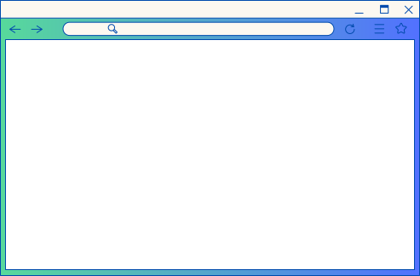

SMART INDIA HACKATHON 2022
TEAM :
THE GIRLS SQUAD
MINISTRY/ORGANIZATION NAME: Defence Research and Development Organisation (DRDO), Ministry of Defence
PS CODE: NR1168
THEME NAME: MedTech / BioTech / HealthTech
PROBLEM STATEMENT : Develop Application to regulate Private health care sector in India from exploiting people during medical emergencies and pandemic situations
TEAM LEADER NAME: Amruta Kashikar
INSTITUTE CODE: C-18376
INSTITUTE NAME: Cummins College of Engineering For Women , Mauja,Nagpur

Slide 2


MEDIPRICE TRACKER
Idea / Approach Details
An app-based solution that provides details of all the medical facilities and their prices provided by hospitals.
This can be expanded to all States and UTs in the future.
The app will contain the following users :
Users
Hospitals
Admin

Slide 3

MEDIPRICE TRACKER
There will be 3 interfaces in the application one for the users another for the hospitals and the last one for the admin.
Users Interface
The user can search for any facility and list of hospitals providing that facility is shown
Raise complaint feature for having a check if any hospital charges more amount than mentioned
Users have to upload an Aadhar card to raise a complaint and describe their issue

Slide 4
MEDIPRICE TRACKER
Hospitals Interface
The verified mark is given by the admin to avoid malpractice
When the hospital enters all details of facilities provided then the section will get locked
To make any modification in facilities/prices request to admin must be sent for enabling it
The last section here will be the complaints resolving section where the hospital has to resolve messages sent by the admin

Slide 5
MEDIPRICE TRACKER
Admin Interface
The homepage will consist of 3 parts
In the account verification admin has to verify hospital details before approving the hospital to create an account in the app.
Next is enabling the modification of the price by hospitals after hospital requests to enable modification.
After that, the admin will have a complaint management section where the admin can view all the complaints lodged by users

Slide 6
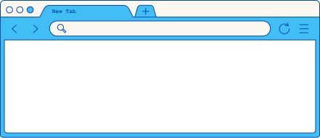

MEDIPRICE TRACKER
Technology stack
Language
Framework
Database
Java
Native Android
Firebase

Slide 7
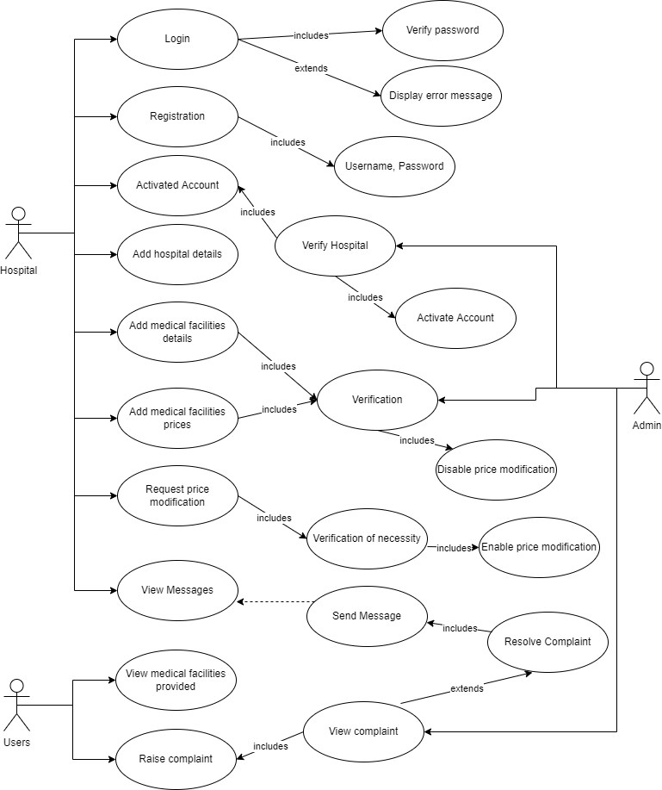
MEDIPRICE TRACKER
Use Case Diagram

Slide 8
MEDIPRICE TRACKER
Dependencies
Users
Hospitals
Cloud Service by Firebase
Show Stoppers
Lack of Users
Lack of Hospitals

Slide 9
Team Member Details
Name | Branch | Stream | Year
Team Leader : Amruta Kashikar | BE | CE | III
Vaishali Pathania | BE | CE | III
Srimoyee Dutta | BE | CE | III
Aditi Bhardwaj | BE | CE | III
Harshal Jodangade | BE | CE | III
Divya Wandhare | BE | CE | III

Slide 10
Thank you!

